Slide 1

UNIT 7 MAKING PLANS 2: TELLING TIME
GE343/10700309 ENGLISH CONVERSATION

Slide 2
UNIT 7: LANGUAGE FOCUS
Seasons
Time of the day
Time
Talking about time

Slide 3
UNIT 7: SLIDE STRUCTURE
Warm-up 1:
Warm-up 2:
Activity 1:
Activity 2:
Activity 3:
Activity 4:
Activity 5:
Activity 6:
Let’s review!: Exercise 1, 2
Tips:

Slide 4
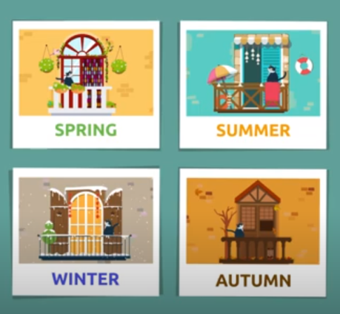
1. What is your favorite season? 2. What comes to your mind when you think of ‘spring’? 3. What comes to your mind when you think of ‘summer’? 4. What comes to your mind when you think of ‘autumn’? 5. What comes to your mind when you think of ‘winter’? 6. How many seasons in Thailand? Do you like the ‘rainy’ season?
Warm-up 1: Seasons
1.1 Watch the VDO and answer the questions
The four seasons of the year for kids - Which are the seasons? - Spring, Summer, Autumn and Winter
https://www.youtube.com/watch?v=_6cG913j6kc

Slide 5
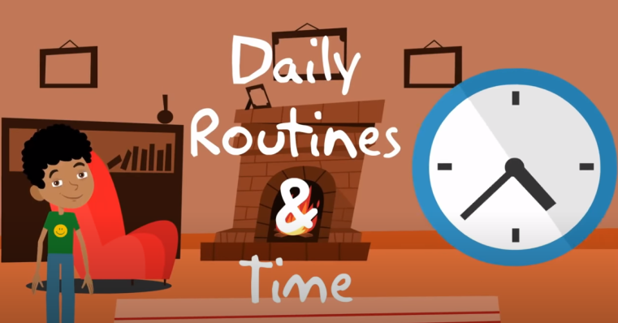
Warm-up 2: Time of the day
1.1 Watch the VDO and learn
Time and Daily Routines
https://www.youtube.com/watch?v=zHWtWOIn3RY
In the morning In the afternoon In the evening At night | What do you do in the morning? What do you do in the afternoon? What do you do in the evening? What time do you go to bed at night?

Slide 6
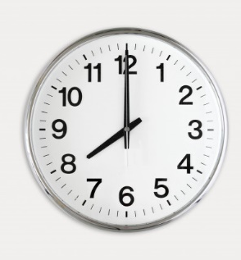
Activity 1: Telling time
TWO ways of telling time
O’clock =
-Use ‘o’clock’ for precise hour = the ‘long hand’ is at 12
= 8 o’clock
-Two options of 12 numbers or 24 numbers
= 8 o’clock
20 o’clock
24-hour = a.m. / p.m.

Slide 7
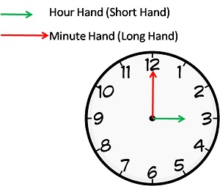
Activity 2: Telling Time
Language Pattern for O’clock style
__(minute/s)__ past ten
__(minute/s)__ to ten
half past = 30 minutes > half past 10 = 10.30
*Never use ‘half to’
A quarter = 15 minutes > a quarter past 10 = 10.15
> a quarter to 10 = 9.45

Slide 8
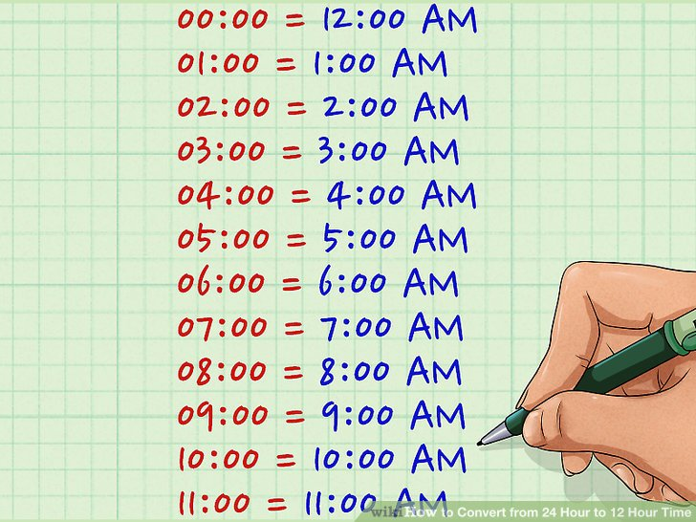
Activity 3: A.M. / P.M.
From the VDO, draw the A.M. / P.M. clocks
AM
PM

Slide 9
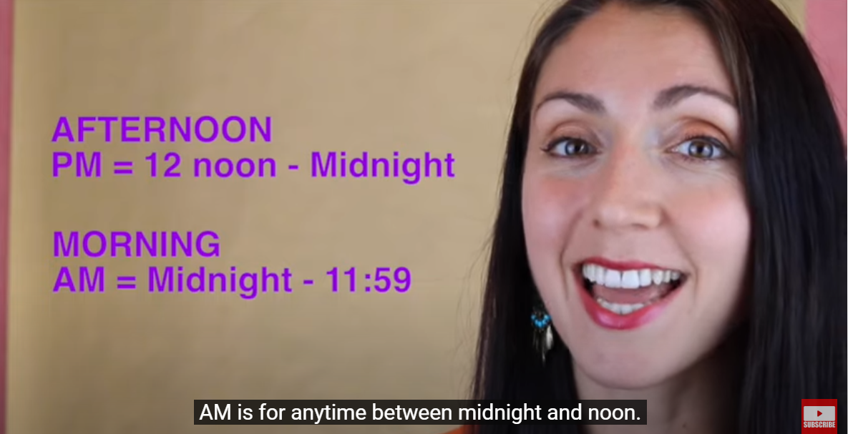
Activity 4: Telling time
Watch the VDO and learn
https://www.youtube.com/watch?v=b9gtewVjkJ0&list=PLLyuV1N4AhvS7zyxyUaZgAFCELZ3hnLeq&index=17&t=157s
Telling the Time: British English
Excuse me, have you got the time?
What’s the time?
Do you know what time it is?
What time is it?

Slide 10
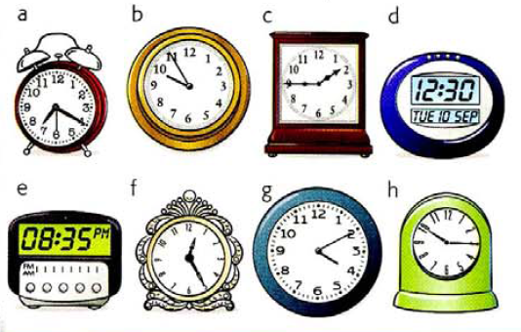
Activity 5: Telling Time
Look at the time below and say each of them.

Slide 11
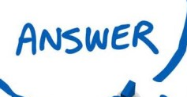
Activity 3: Telling Time
Look at the time below and say each of them.
It’s seven twenty.
It’s twenty past seven.
It’s nine fifty-five.
It’s five to ten.
It’s one forty-five.
It’s fifteen to two.
It’s twelve thirty.
It’s half past twelve.
It’s eight thirty-five.
It’s twenty-five to nine.
It’s twelve twenty-five.
It’s twenty-five past twelve.
It’s four ten.
It’s ten past four.
It’s ten fifteen.
It’s fifteen past ten.

Slide 12
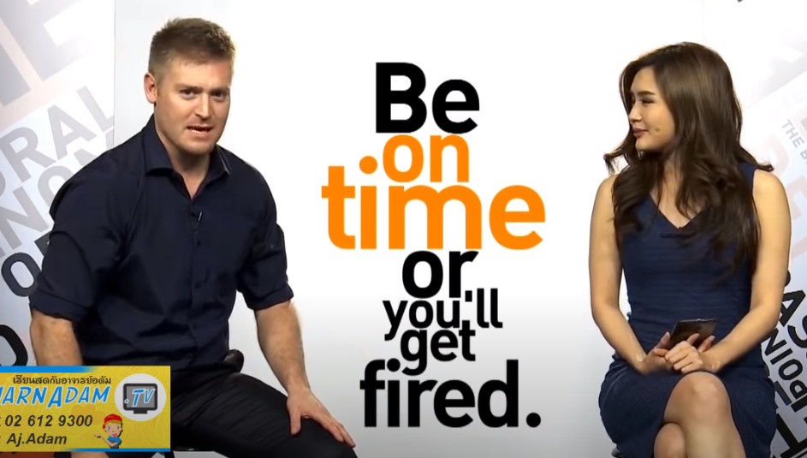
Activity 6: Telling Time
Language Pattern 2
Watch the VDO and learn
On Time กับ In Time ใช้ต่างกันอย่างไร
https://www.youtube.com/watch?v=RNIn2sOzQJI
early | -The class started at 8.00. You arrived at 7.50. You are early today. -The early bird gets the worm.
on time (ตรงเวลา) | -You need to be on time for your flight or you’ll miss it. -Be on time or you’ll get fired. -Be on time as much as you can.
in time (มาทัน) | -I was in time for my flight. So, I could just see you here. -I wasn’t in time for the meeting. So, my boss was upset.
late | -The class started at 8.00. You arrived at 8.30. You are late today. -Don’t be late or you’ll miss the train.

Slide 13
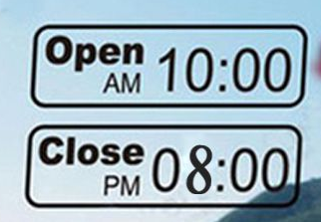
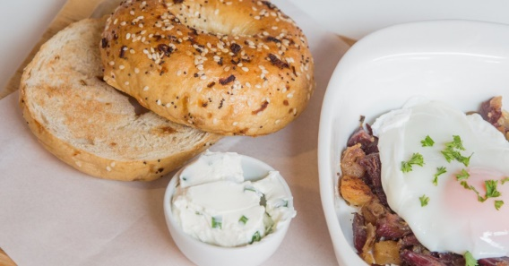
Let’s review! Exercise 1: Choose the best answer.
Joe: Morning, Tina. Sorry, I’m terribly early / late today.
Tina: Oh, I thought you wouldn’t show up. That’s alright.
Joe: What time will the meeting start?
Tina: It’ll start at half past 8 / half past 9 (9.30).
Joe: So, we’ll still have time. Do you want to grab quick breakfast?
Tina: That’ll be great. Let’s get in here. But is the café open yet?
Joe: The sign says it’s open at 10 am / 8 pm. Look at the picture >>>
Tina: That’s too bad. How about this bagel shop?
Joe: It looks great. Let’s go with that. And it’s on me.
Tina: You don’t have to.
Joe: Please let me. I feel so bad to have you wait today.
Tina: Alright then. But next time, it’s on me.
Joe: Don’t worry about it. And I promise I won’t be early / late again.
Tina: We’ll see.

Slide 14
Let’s review! Exercise 2: Answer the question
What time did you wake up today?
What time did you go to bed last night?
What is your favorite season? And why?
What time is it now?
What time do you usually have dinner?

Slide 15
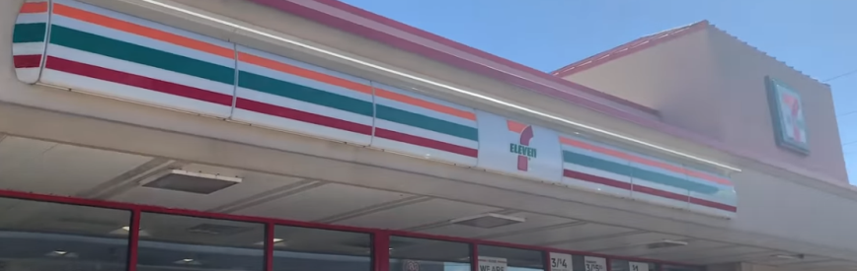
TIPS 1: Watch the VDO
https://www.youtube.com/watch?v=GIPvT9rFHaY&list=PLLyuV1N4AhvS7zyxyUaZgAFCELZ3hnLeq&index=19&t=467s
เที่ยวเซเว่นที่เมกากับฝรั่งสองคนที่พูดไทยได้ || Vlog #9
1. How do Americans say dates; day/month/ year or month/day/year?
2. Why “7-11” is important to them?
3. What is Sam’s favorite candy?
4. What do you call “น้ำอัดลม” in English?
5. Would you prefer 7-11 in Thailand or America?
6. How do you pronounce the word “dollars”?
7. What is “AC”?

Slide 16
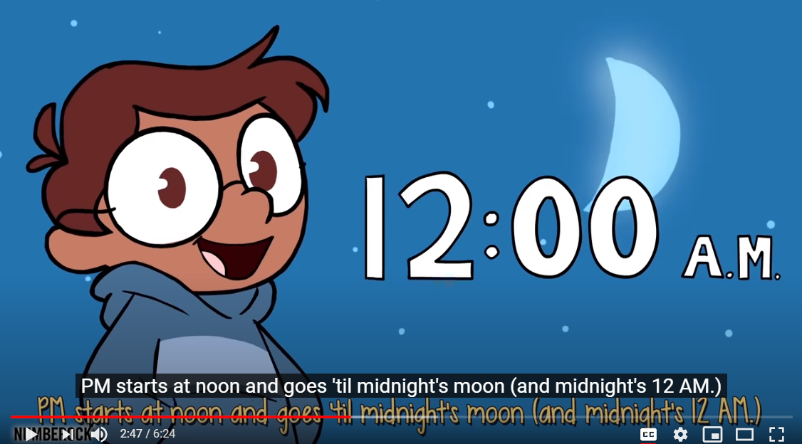
TIPS 2: Watch the VDO
https://www.youtube.com/watch?v=h6RNkQ7lU8Y&t=76s
Telling Time Song for Kids | Telling Time to 5 Minutes

Slide 17
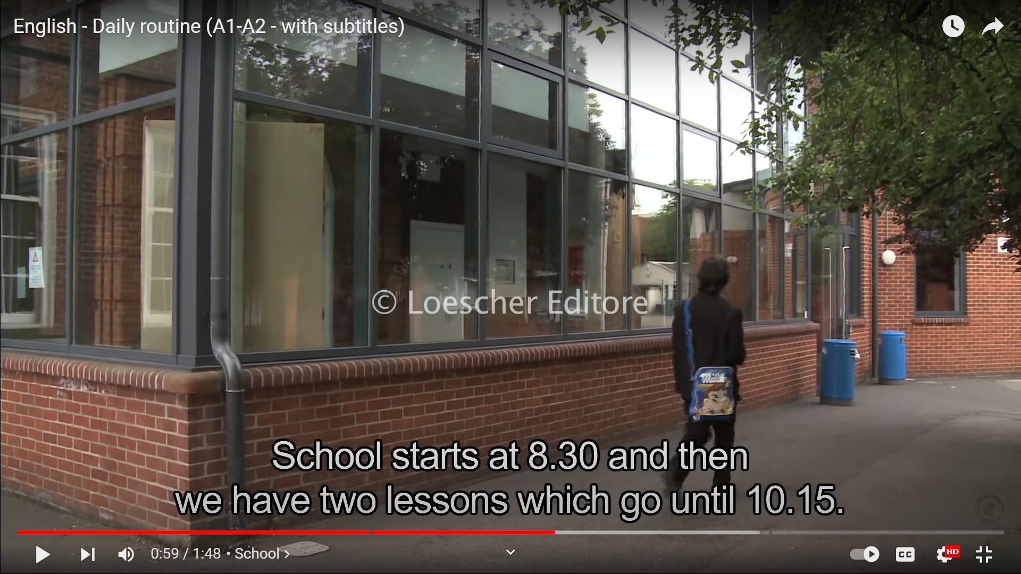
TIPS 3: Watch the VDO
https://www.youtube.com/watch?v=RP1AL2DU6vQ
English - Daily routine (A1-A2 - with subtitles)

Slide 18
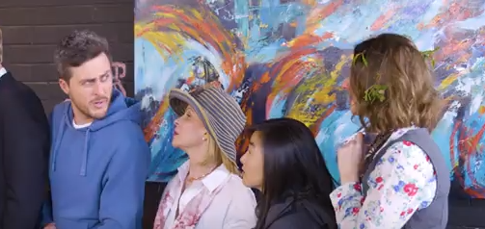
TIPS 4: Watch the VDO https://www.youtube.com/watch?v=PHoi5eRy9mc Melbourne: Four Seasons
How many seasons are there?

Slide 19


